Slide 1
第九讲 MSP430的时钟模块
牛金海

Slide 2
主要内容
时钟模块
1、时钟模块的设计要求
2、MSP430F4XX时钟模块
二、低功耗模块
1、上电复位与上电清除
2、掉电保护
3、低功耗
三、电源电压检测模块
1、SVS的结构与特点
2、SVS寄存器
3、SVS应用举例

Slide 3
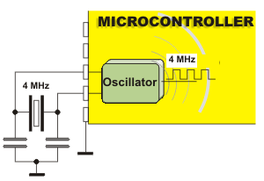
1、时钟模块的设计要求
1、数字系统中，系统功耗与什么相关？
2、回顾51 单片机的系统时钟模块？
Notes:
频率成正比

Slide 4
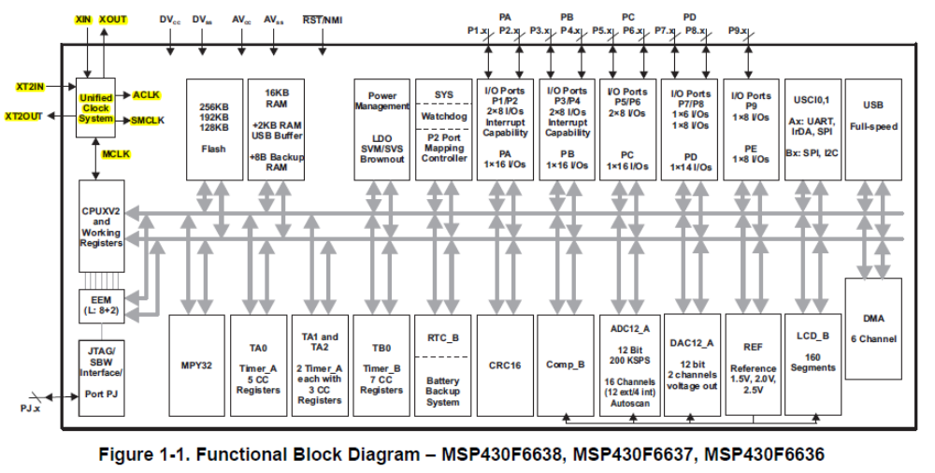
时钟模块在系统中的位置

Slide 5
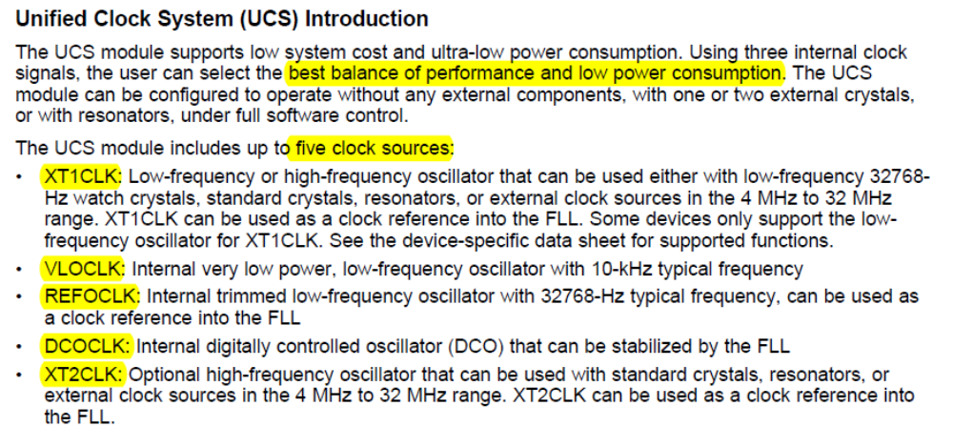
时钟系统介绍
有5种可选时钟源，可以在性能和低功耗之间做很好平衡性选择。
Notes:
unified_百度翻译
unified英['ju:nɪfaɪd]美['ju:nɪfaɪd]adj.统一的; 一元化的; (unify 的过去式和过去分词) ; 统一标准的;v.统一; 使联合( unify的过去式和过去分词 ); 使相同; 使一致;[例句]We should carry out the policy of integrating unified planning with the principle of adaptation to local conditions.
我们应该执行计划同因事制宜的原则相结合的政策。
[其他]原型： unify
trimmed英[trɪmd]美[trɪmd]adj.平衡的，纵倾的;v.修剪; 装饰; 整理( trim的过去式和过去分词 ); 减少;[例句]I am wearing a plaid nightgown trimmed with white lace.
我穿着一件带有白色蕾丝花边的格子呢睡衣。
[其他]原型： trim

Slide 6
主要时钟输入源：
主要时钟输入源：
LFXT1CLK 低频时钟源：由32kHz晶体、标准晶体或者陶瓷谐振器、外部450K-8M的时钟源产生；
XT2CLK 高频时钟源：由标准晶体或者陶瓷谐振器、外部450K-8M的时钟源产生；
DCOCL 数字控制RC振荡器：片内数字控制RC振荡器，经常用作系统或者外设的时钟信号，其稳定度可由FLL+硬件控制；

Slide 7
概念：What is DCO？
DCO：A digitally controlled oscillator or DCO is a hybrid digital/analogue electronic oscillator used in synthesizers. The name is an analogy with "voltage-controlled oscillator". DCOs were designed to overcome the tuning stability limitations of early VCO designs.

Slide 8
What is FLL？
A frequency-lock, or frequency-locked loop (FLL), is an electronic control system that generates a signal that is locked to the frequency of an input or "reference" signal. This circuit compares the frequency of a controlled oscillator to the reference, automatically raising or lowering the frequency of the oscillator until its frequency (but not necessarily its phase) is matched to that of the reference.
A frequency-locked loop is an example of a control system using negative feedback. Frequency-lock loops are used in radio, telecommunications, computers and other electronic applications to generate stable frequencies, or to recover a signal from a noisy communication channel.
课堂思考题：MSP430芯片为什么要引入DCO以及FLL技术？

Slide 9
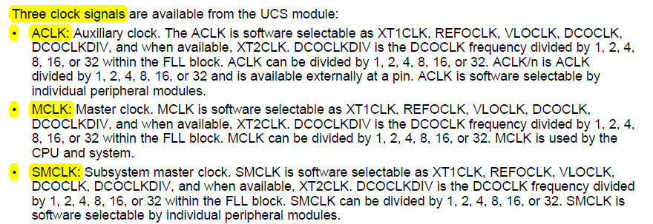
一、时钟模块
输出三种不同的时钟信号：ACLK辅助时钟，MCLK主系统时钟，SMCLK子系统时钟
Notes:
A digitally controlled oscillator or DCO is a hybrid digital/analogue electronic oscillator used in synthesizers. The name is an analogy with "voltage-controlled oscillator". DCOs were designed to overcome the tuning stability limitations of early VCO designs.
Confusion over terminology
The term "digitally-controlled oscillator" has been used to describe the combination of a voltage-controlled oscillator driven by a control signal from a digital-to-analog converter, and is also sometimes used to describe numerically-controlled oscillators.
This article refers specifically to the DCOs used in many synthesizers of the 1980s. These include the Roland Juno-60, Juno-106, JX-3P, JX-8P, and JX-10, the Korg Poly-61 and Poly 800, and some instruments by Akai and Kawai.
Relation to earlier VCO designs
Many voltage-controlled oscillators for electronic music are based on a capacitor charging linearly in an op-amp integrator configuration[1]. When the capacitor charge reaches a certain level, a comparator generates a reset pulse, which discharges the capacitor and the cycle begins again. This produces a rising ramp (or sawtooth) waveform, and this type of oscillator core is known as a ramp core.
The typical DCO design replaces the comparator in the ramp core with reset pulses generated from a counter or microprocessor. This gives the design digital frequency stability, whilst retaining a true analogue waveform output. Aside from the way reset pulses are generated, the typical VCO ramp core and the DCO are identical. Both produce a ramp waveform from which other waves are derived by waveshaping.
Historical context
In the early 1980s, many manufacturers were beginning to produce polyphonic synthesizers. The VCO designs of the time still left something to be desired in terms of tuning stability[2]. Whilst this was an issue for monophonic synthesizers, the limited number of oscillators (typically 3 or fewer) meant that keeping instruments tuned was a manageable task, often performed using dedicated front panel controls. With the advent of polyphony, tuning problems became worse and costs went up, due to the much larger number of oscillators involved (often 16 in an 8-voice instrument like the Yamaha CS80[3] from 1977 or Roland Jupiter-8[4]) from 1981. This created a need for a cheap, reliable, and stable oscillator design. Engineers working on the problem looked to the frequency division technology used in electronic organs of the time and the microprocessors and associated chips that were starting to appear, and developed the DCO.
The DCO was seen at the time as an improvement over the unstable tuning of VCOs. However, it shared the same ramp core, and the same limited range of waveforms. Although sophisticated analogue waveshaping is possible[5], the greater simplicity and arbitary waveforms of digital systems like direct digital synthesis lead to most later instruments adopting entirely digital oscillator designs.
Operation
A DCO can be considered as a VCO that is syncronised to an external frequency reference. The reference in this case is the reset pulses. These are produced by a digital counter such as the 82C53 chip. The counter acts as a frequency divider, counting pulses from a high frequency master clock (typically several MHz) and toggling the state of its output when the count reaches some predetermined value. The frequency of the counter's output can thus be defined by the number of pulses counted, and this generates a square wave at the required frequency. The leading edge of this square wave is used to derive a reset pulse to discharge the capacitor in the oscillator's ramp core. This ensures that the ramp waveform produced is of the same frequency as the counter output.
Problems with the design
For a given capacitor charging current, the amplitude of the output waveform will decrease linearly with frequency. In musical terms, this means a waveform an octave higher in pitch is of half the amplitude. In order to produce a constant amplitude over the full range of the oscillator, some compensation scheme must be employed. This is often done by controlling the charging current from the same microprocessor that controls the counter reset value.
See also
Voltage-controlled oscillator
Numerically-controlled oscillator
Direct digital synthesis
References
^ Chamberlin, Hal (1985). "Basic Analog Modules, Voltage-Controlled Oscillator". Musical Applications of Microprocessors. section 6, p.181.
^ Russ, Martin (2004). "Early versus modern implementations". Sound Synthesis and Sampling. section 2.6.1, p.137.
^ Yamaha CS80, Vintage Synth Explorer
^ Roland Jupiter 8, Vintage Synth Explorer
^ STG Wavefolder, STG Soundlabs website
背景知识：
在实际的通信系统中，携带数字信息的信号通常是由某种类型的载波调制方式发送的，传送信号的带宽限制在以载波为中心的一个频段上，如双边带调制，或在邻近载波的频段上，如单边带调制。无论何种调制方式，在发送端均需要一个高频载波将信息调制上去，以减小信号衰落，相干解调时在接收端也需要一个与发送端同频同相的高频载波将信息从高频上解调下来。为了产生这个高频载波，在数字电路中是采用数控振荡器(NCO)，也称为直接数字频率合成器〔DDS)，它的输出频率和相位可以受人为控制，从而满足各种需要。
基本原理：
下图为NCO的工作原理框图:
数控振荡器一般由基准时钟(fclk)、相位字寄存器、相位累加器以及幅度/相位转换电路等部分组成。在基准时钟的作用下，每一个时钟周期存贮在相位字寄存器里的值都由相位累加器进行累加，相位果加器的输出作为查找表的输人，从而得到相对应的幅度值。根据奈奎斯特采样定律，输出信号的频率应小于基准时钟的1/2。
相位累加器输出(△Ф)的数值和系统的频率(fclk)决定了输出频率(fout),它门的关系如下:
N是相位寄存器的位数，N值的大小决定了频率分辨率(fres )，有
在这里假设，fclk=128MHz, N=32，可以计算出NCO的频率分辨率fres=0.0298Hz
相位累加器是决定NCO电路性能的一个关键部分。我们可以采用了Altera的加法器宏功能模块形成一个32bit的累加器，它以流水线处理方式进行工作。
相位/幅 度转换电路是NCO电路中的另一个关键部分，在设计中面临的主要问题就是资源的开销。
一般电路采用ROM结构，相位累加器的输出是一种数字式锯齿波，通过取它的若干位作为ROM的地址输人，而后通过查表和运算，ROM就能输出所需波形的量化数据。
在APEX器件中，ROM由EAB实现，ROM表的尺寸随着地址位数或数据位数的增加成指数递增关系，因此在满足信号性能的前提条件下，如何减少资源的开销就是一个重要的问题。
在实际设计时，要充分利用信号周期内的对称性和算术关系来减少EAB的开销。
上图为产生正弦信号的相位/幅度转换电路，相位累加器累加值的最高位(MSB )和次最高位(MSB-1)的组合作为象限确定模块的输人，由此来确定输出信号所在的相平面和极性符号，如表所示。
正弦查找表存贮了1/4周期的正弦幅度数据，通过象限确定模块就可以完成完整的正弦波的形成。这里采用了一个256 x 8的ROM宏模块。地址线和数据线输出均为8bit, 8bit地址分别对应相位累加器的30-23bit的输出数据。正弦查找表的输出是无符号的8bit数据，并不能代表正弦波形。求补模块根据象限确定模块的输出符号位的极性来对查找表输出数据进行求补，并把此符号位和正弦查找表输出的高7bit组合作为最终正弦波输出信号。

Slide 10
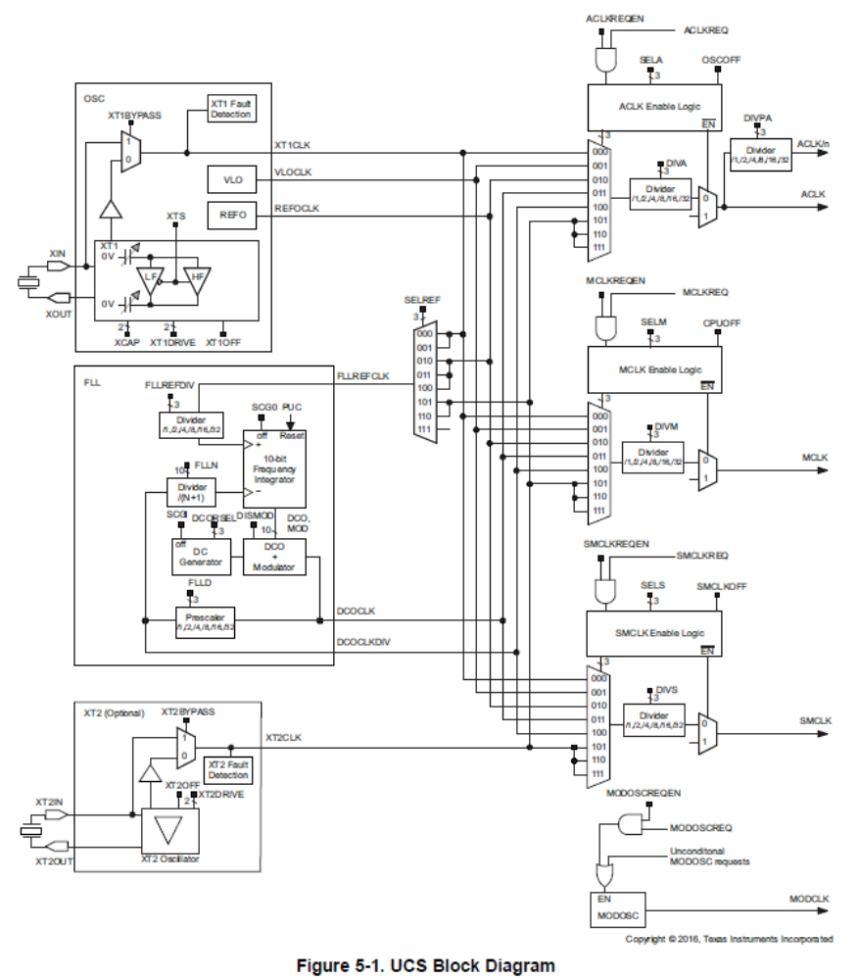
时钟模块的结构框图
慢速外设
CPU和
系统
快速外设

Slide 11
4种时钟输出信号
时钟输出信号
ACLK 辅助时钟:来自LFXT1CLK信号，可由软件选作各外围模块的时钟信号，一般用于低速设备；
ACLK /n:ACLK经过1、2、4、8分频之后由引脚P1.5输出，仅供外部电路使用，保证MPS430F4XX和MSP430X1XX系统时钟的兼容性；
MCLK主系统时钟:由软件选择来自LFXT1CLK 、 XT2CLK 、 DCOCL 三者之一。然后经过1、2、4、8分频得到，MCLK主要用于CPU和系统；
SMCLK子系统时钟:由软件选择来自 XT2CLK 、 DCOCL 三者之一。然后经过1、2、4、8分频得到，MCLK主要用于高速外设；

Slide 12
本章思考题
1、MSP430芯片时钟频率与功耗有什么关系？
2、MSP430时钟模块有哪几种时钟源？
3、MSP430的时钟模块提供哪几类时钟信号？
4、DCO与FLL的概念？

